Slide 1
Leon’s Third Subject

Slide 2
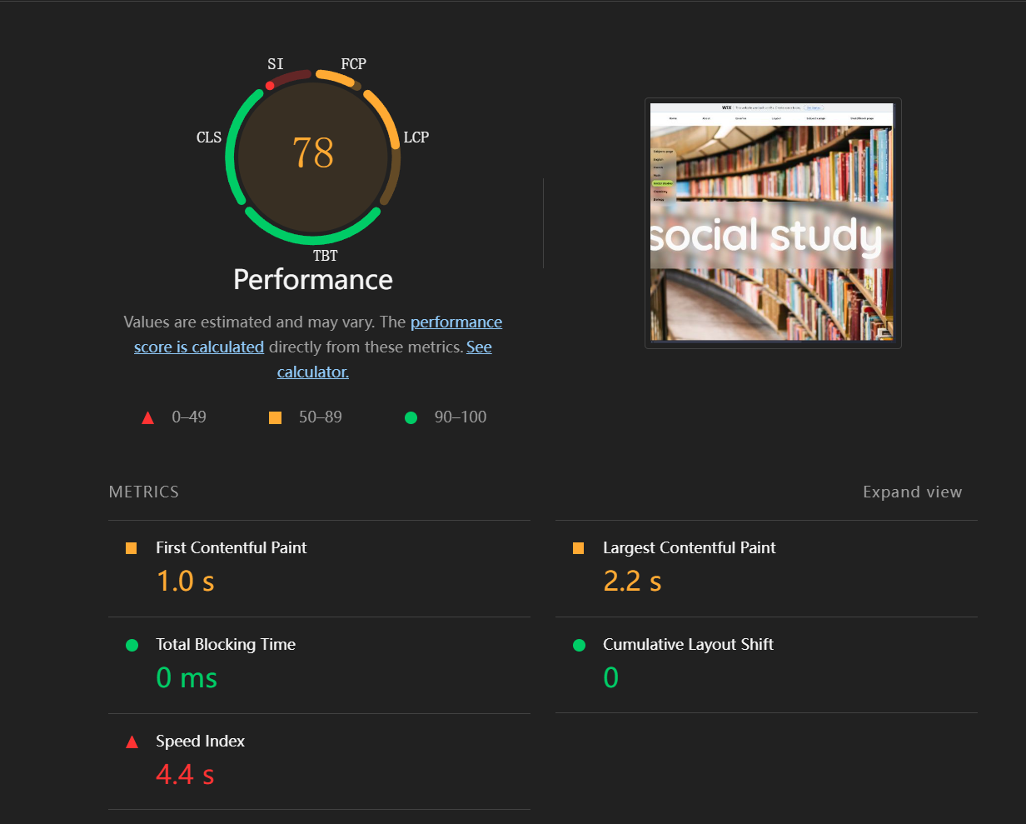
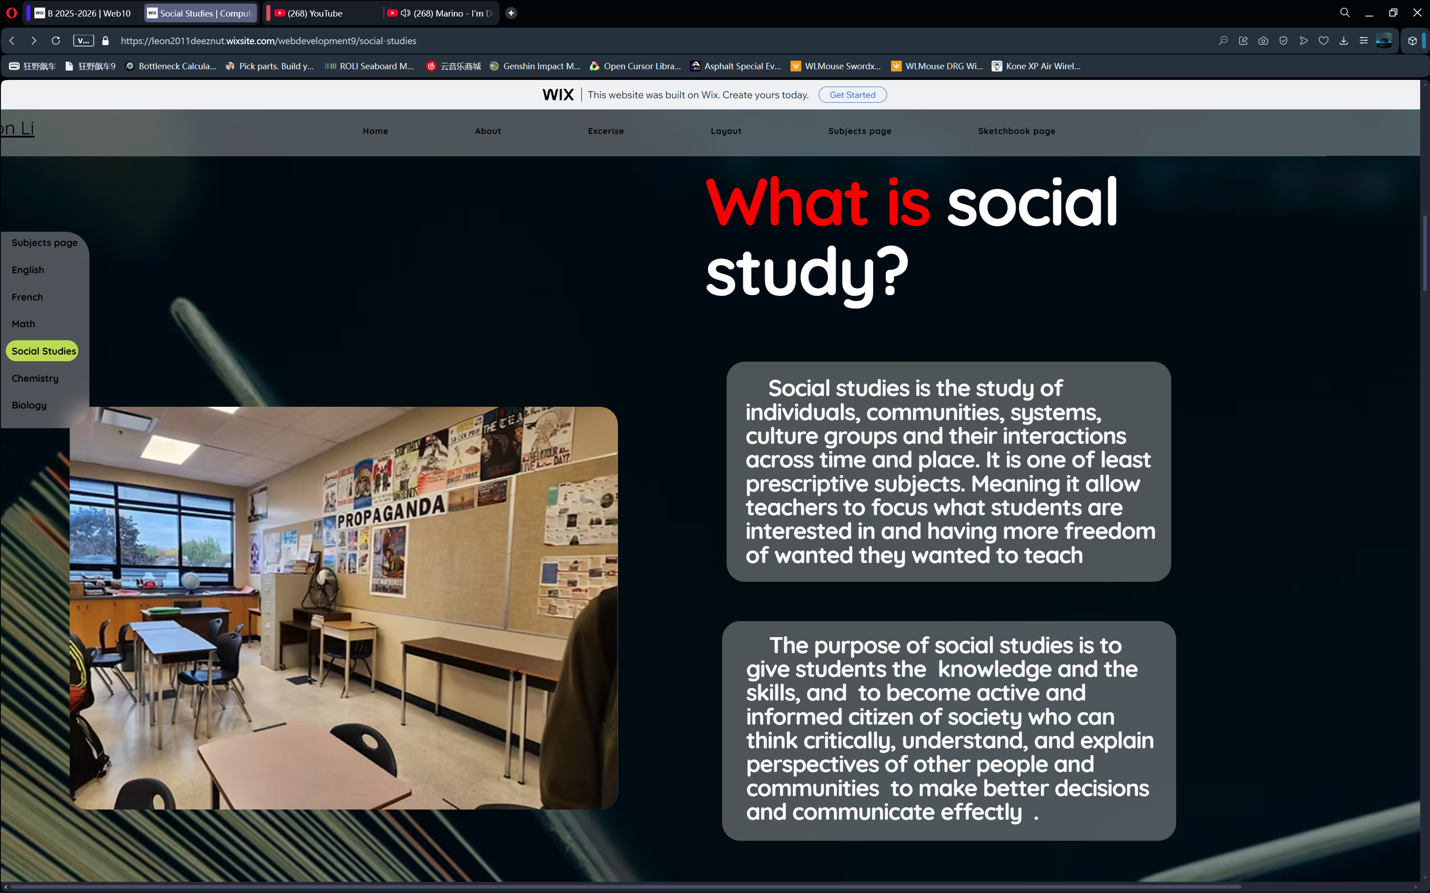
Visuals
Color – 4/5
  Decent contrast
  Mostly consistent color palette.
Images – 3.5/5
  Relatively high quality(sourced photos are mostly above 1080p)
  Poor optimization for certain photos – largest paint taking upwards of 2.2 seconds on a simulated 10mb/s (almost six times the speed of school wifi) network over 40ms of ping
  Alt text present for half of photos
Icons & Graphics – 0/5
  No graphics/icons present
Layout – 3/5
  Great whitespace
  Clear visual hierarchy
  Less that poor grid alignment
  Scaling problems for my 16:10 screen
Center of page

Slide 3
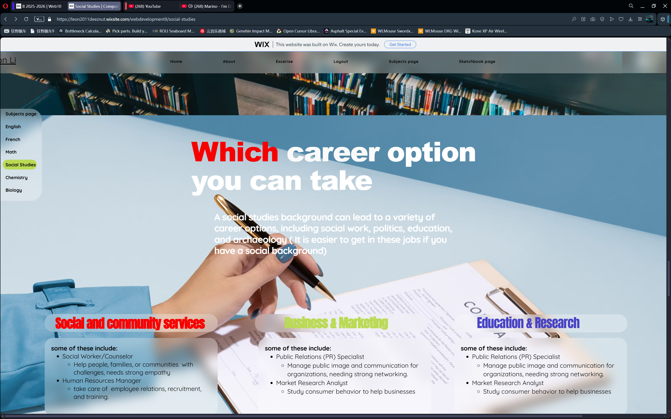
Text
Center of page
Typography – 4/5
  Inconsistent but readable font
  Clear visual hierarchy
Text alignment & layout – 3/5
  Left-aligned at the appropriate places
  Contrast questionable at some places
  Inconsistent sizing/spacing/scaling
Tone & content presentation – 3/5
  Little to no jargon, clear text
  Inconsistent formatting
  Slightly variable tone
  Lots of grammatical mistakes and missed capitalization
Text & Graphic interaction – 4/5
  Decent visual flow
  Text and images aligned

Slide 4
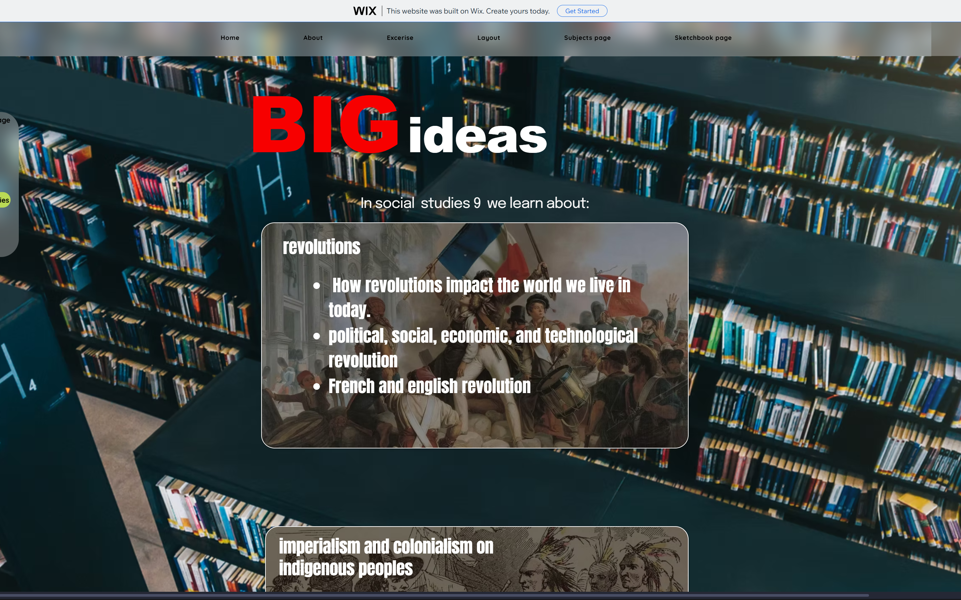
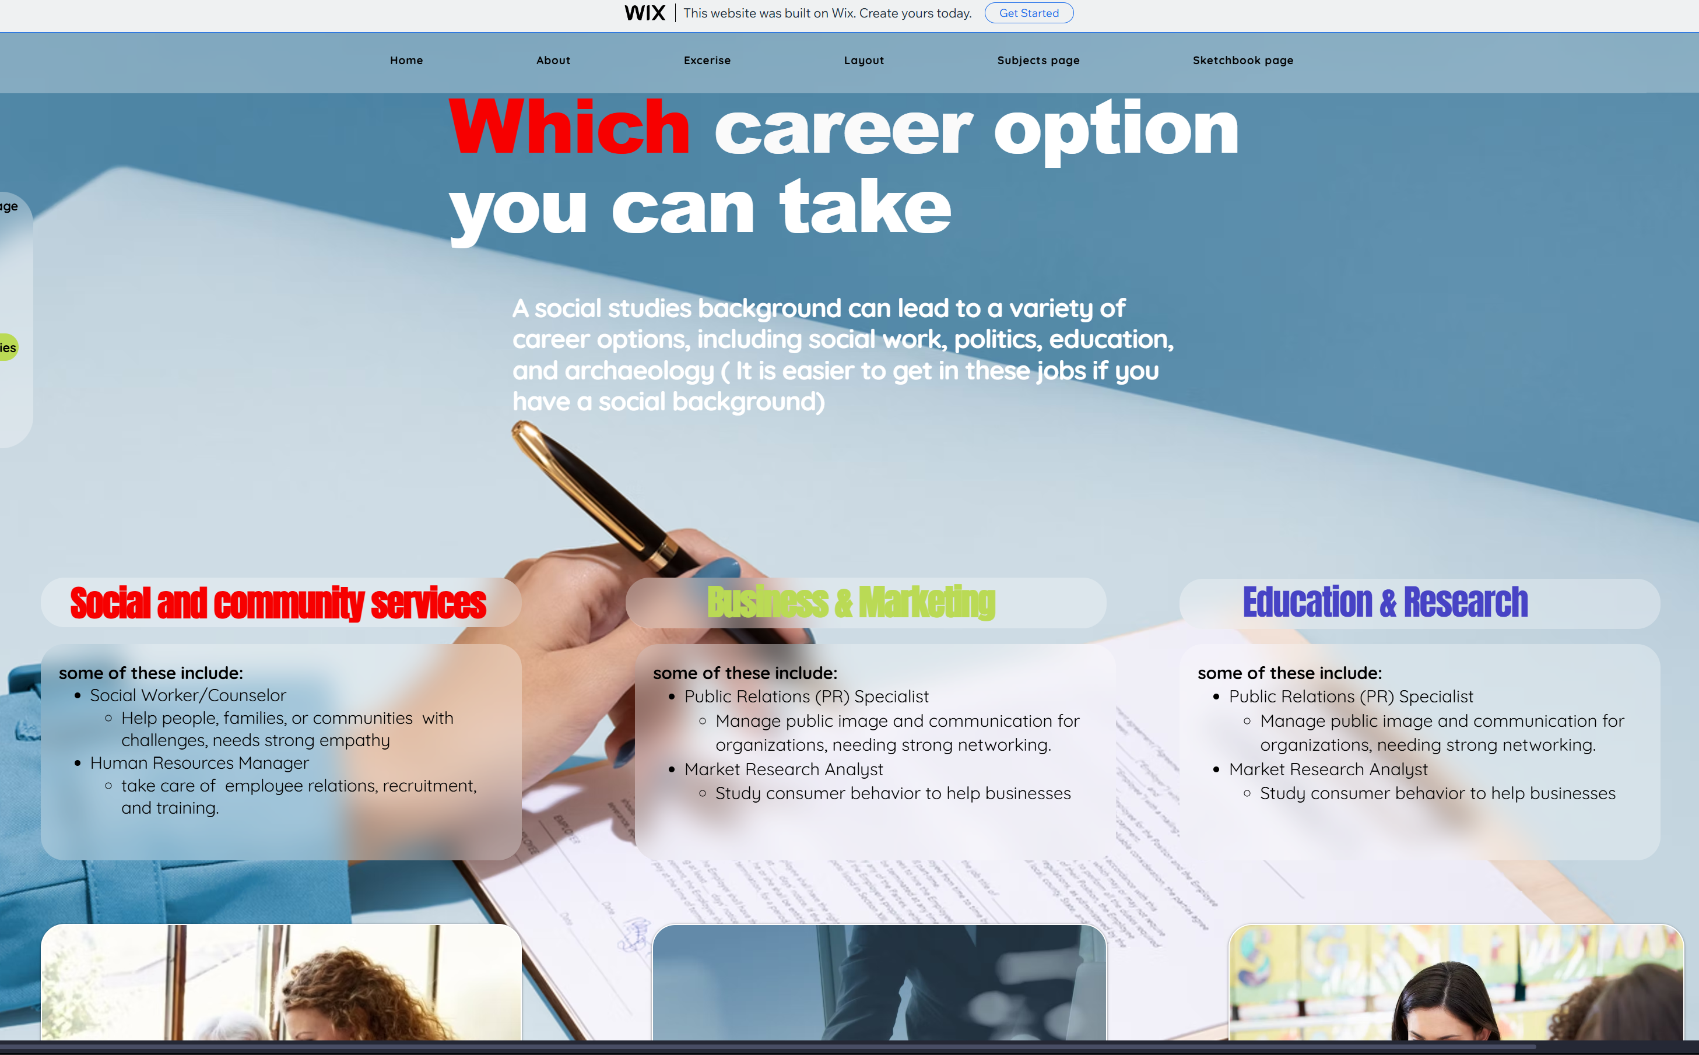
Articles
Title – 5/5
  Clear and highly relevant
Introduction - 4/5
  Gives readers a firm understanding of the outline of the subject
“Definition & scope” - 3/5
  Describes all topics in social studies, but lacks detail
  Only three short bullets for each “big idea”
“Importance” – 4/5
  Introduces some professional positions that utilize topics of Social Studies subject
  Lack of detail.

Slide 5
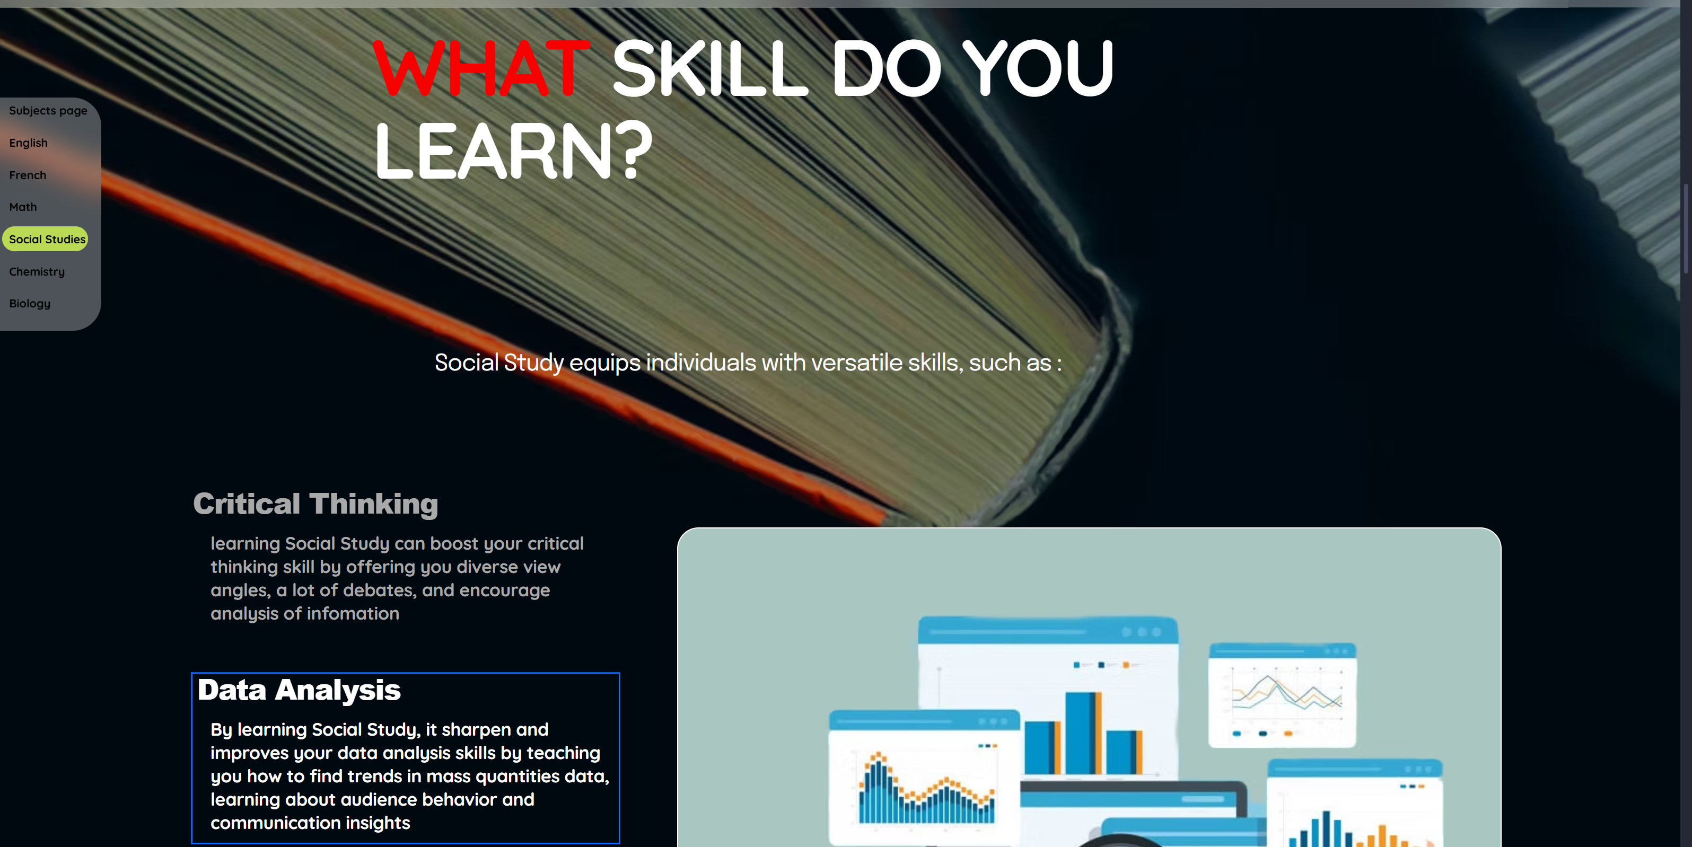
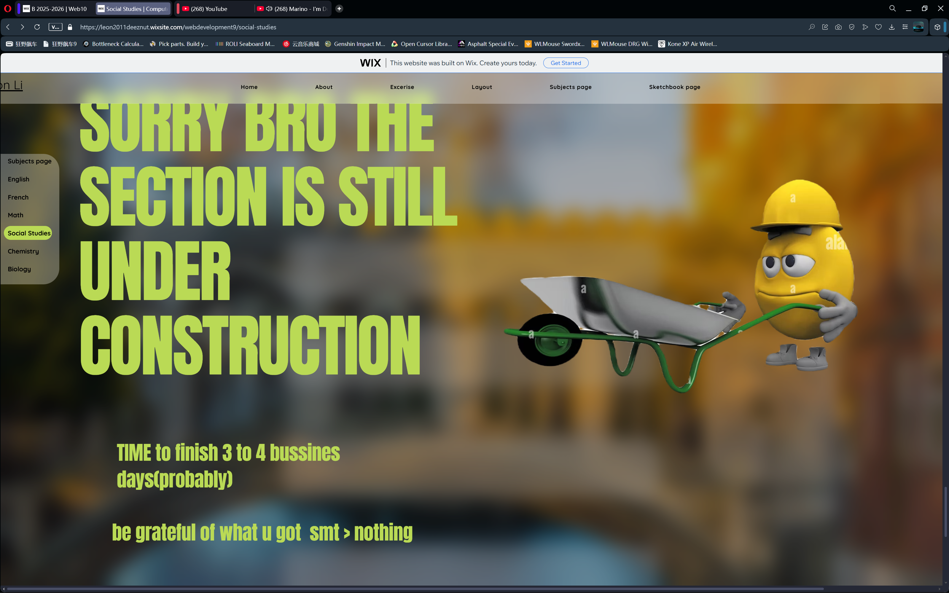
Articles Continued
“Learning Outcomes & Objectives” - 4/5
  Appropriately outlines learning outcomes
  Uses JS for an image that is dependent on the selected text
“Recent Developments/Examples” - 0/5
  Nothing of such topic visible
Conclusion – 0/5
  Nothing of such visible
Style and Format – 4/5
  Mostly formal
  Little to no jargon
  Sightly unclear language
  Appropriate flow

Slide 6
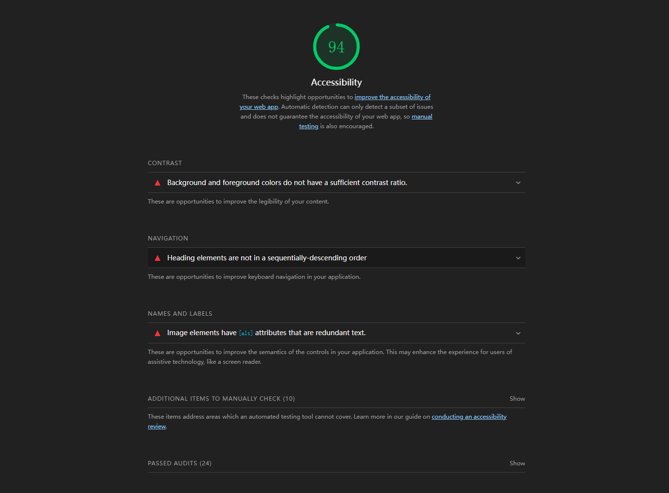
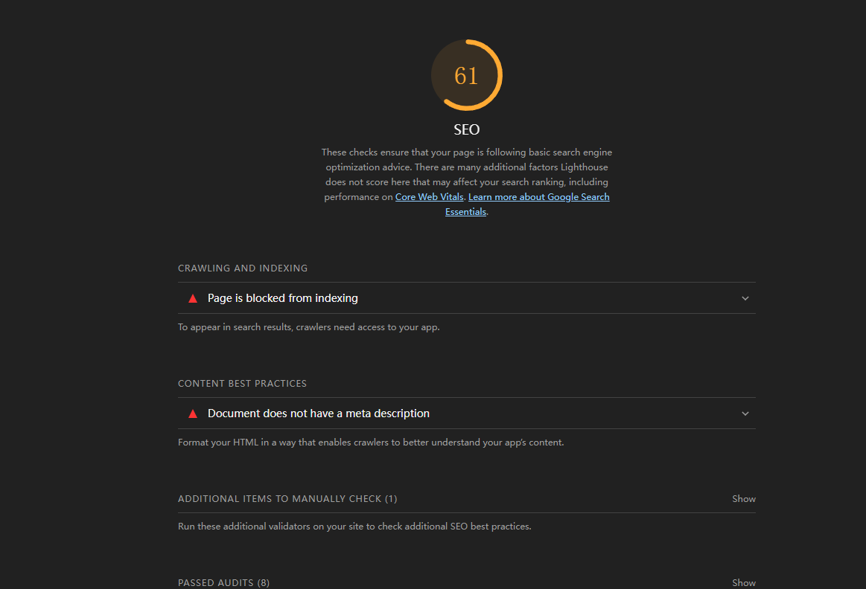
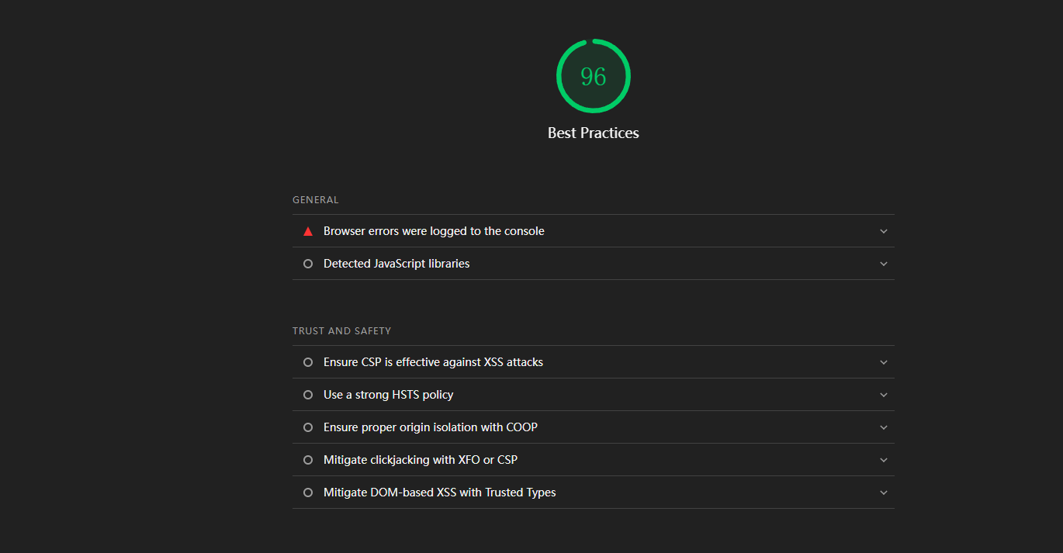
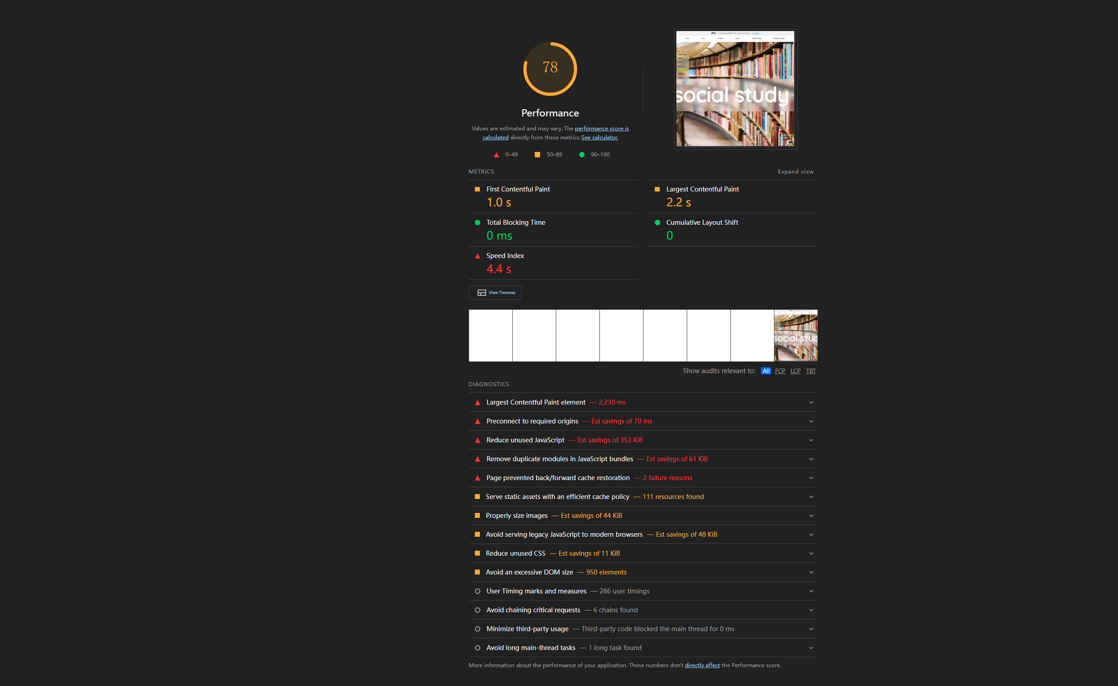
Nitpicks
Unfinished Site
Uncentered Text
Uneven bevels
The “Introduction to Social Studies” background is too stretched
Page title doesn’t need to take up a full screen
No interview
Bad Lighthouse Score
Loads of unused JS
Some heading elements are not in a sequentially-descending order/labeled incorrectly

Slide 7
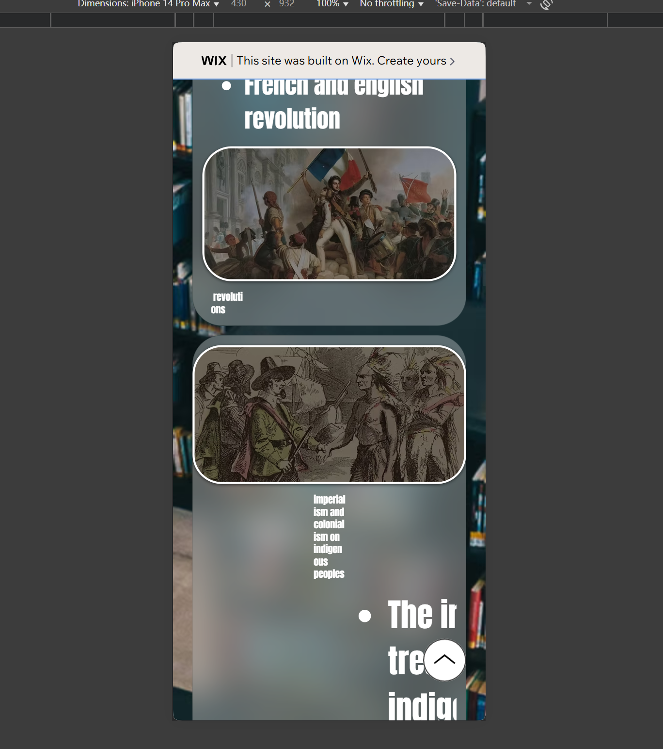
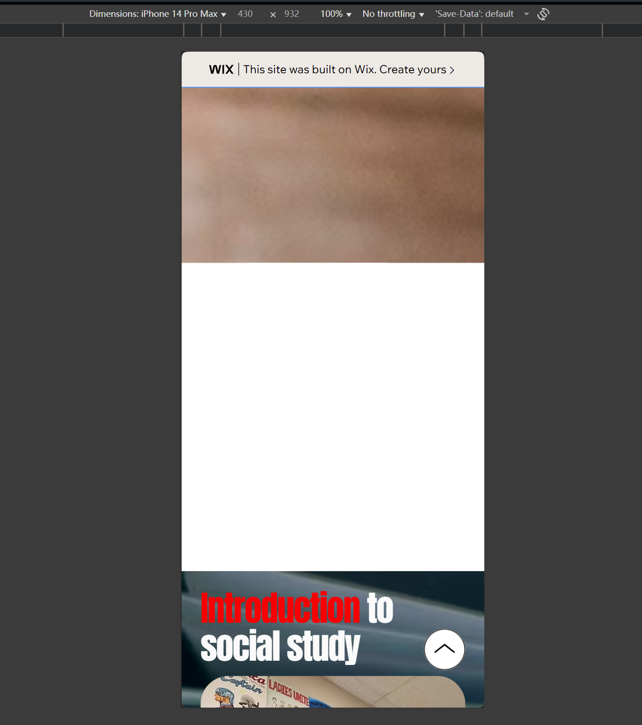
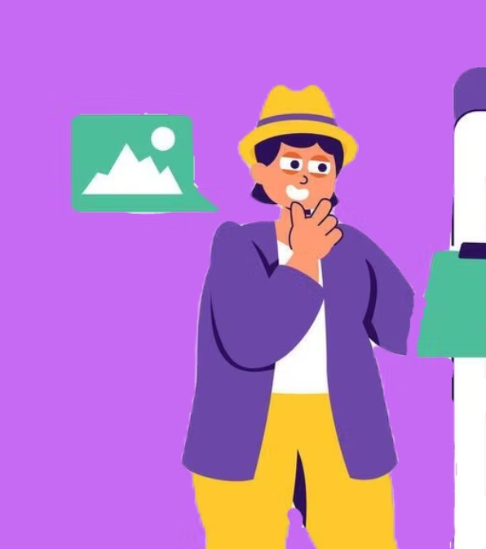
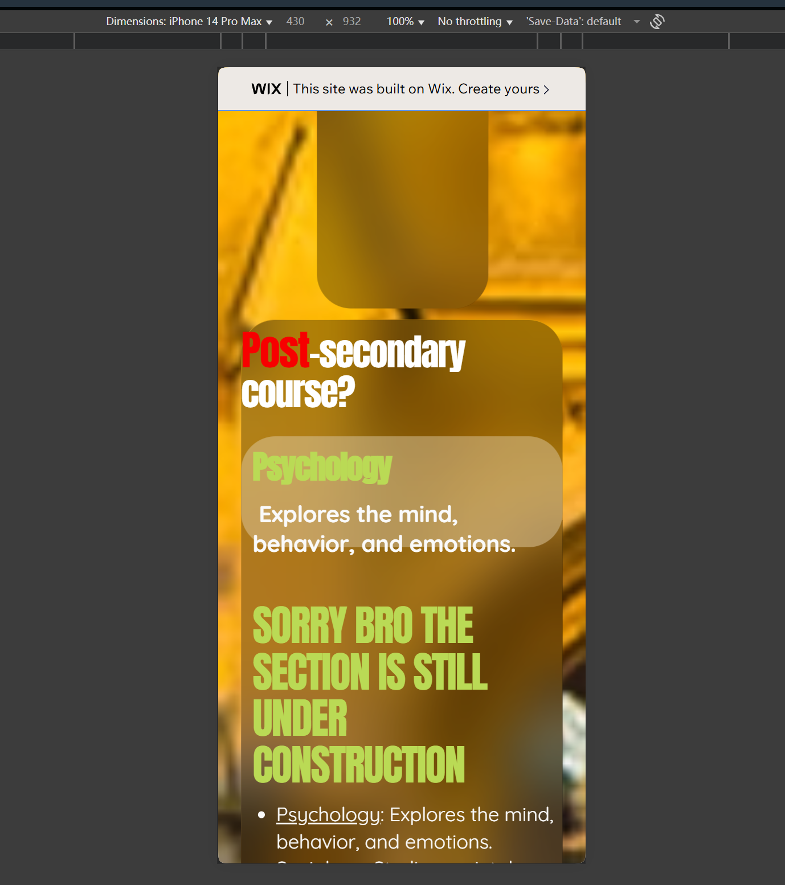
Nitpicks Continued
Some pictures have hand colored in backgrounds
Last image’s blurring doesn’t cover the top properly
Page is blocked from indexing
Animations too slow in certain cases
No dropdown menu for “Subjects Page” in Header
Painful LCP of 6.2 seconds on mobile view
Severe scaling problems on simulated mobile environment
  Text is out of boxes
  Microscopic font size
  Two pages worth of blank space
  Loads of empty text boxes
Overuse of preconnected origins in code
Lots of accidental double spaces

