Slide 2
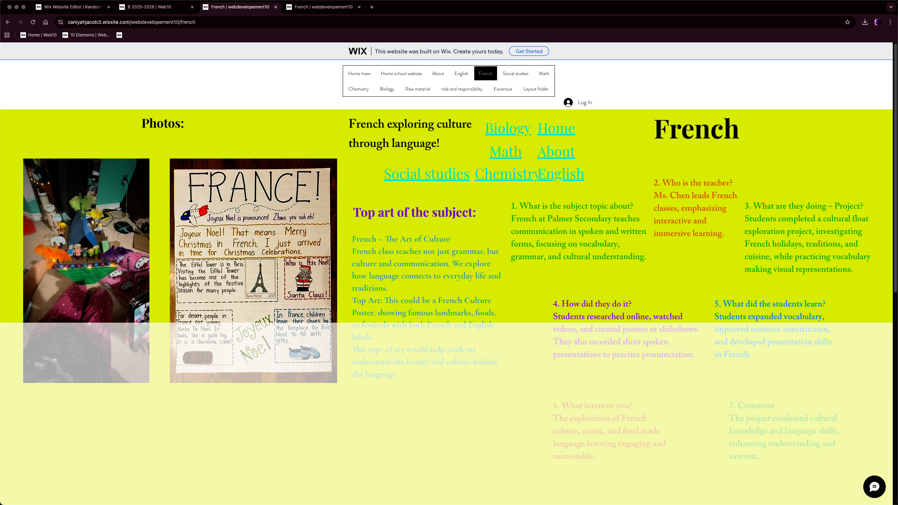
Color
Inconsistent font colors
Lack of contrast for certain texts
Unrelated font colors

Slide 3
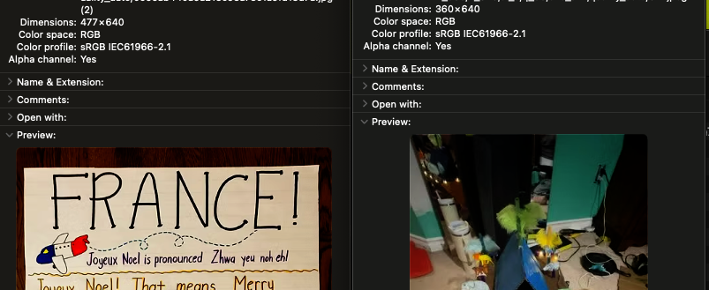
Images & Icons
Image resolution low, should be at least 1080p
Leftmost picture irrelevant to topic
Lack of graphics
No appropriate alt text (defaulted to file name)

Slide 4
Layout
All graphics cluttered on the left side
Minimal visual hierarchy
Elements randomly laid out; no gridlines

Slide 5
Text
Horrendous contrast
Consistent font
Font sizes extremely big on mobile view

Slide 6
Tone
Questionable article quality
Somewhat scannable
Inconsistent tone

Slide 7
Interactions
No visual flow
Overlapping text
Images not related to text
Not aligned with text

Slide 8
Introduction
Unclear and lacking information
Put in an awkward spot
Extremely short

Slide 9
Body
Body (Definition)
  Rushed statements; “written forms, focusing on vocabulary, grammar, and cultural understanding” is very general and uninformative.
  Lacking information
  Also put in an awkward spot
Body (Importance)
  Missing
Body (Learning outcomes)
  Lacking details
  Bland
Body (Developments)
  Could be more descriptive

Slide 10
Styling
Toning is inconsistent
No citations.

Slide 11
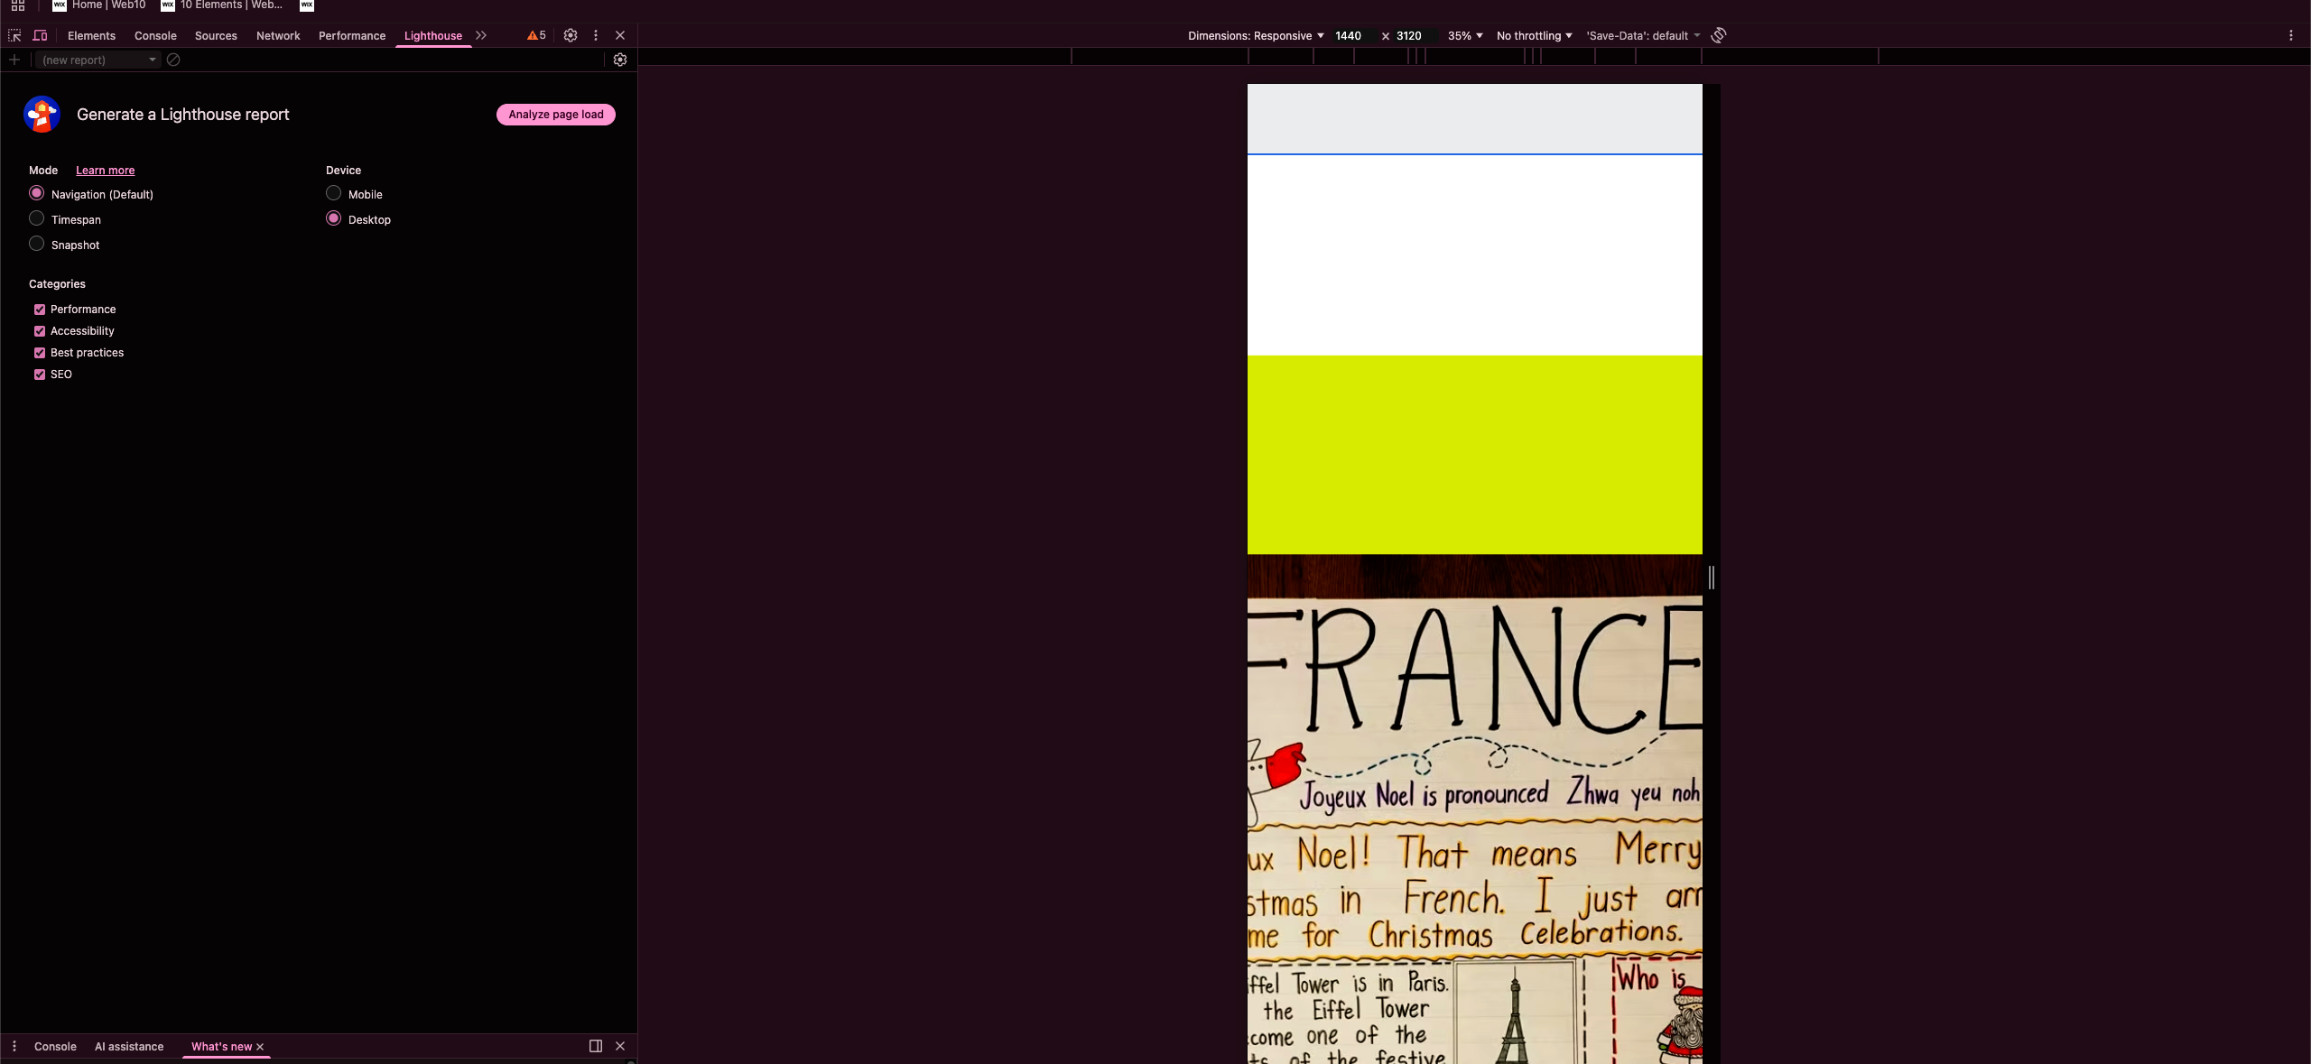
Others
White translucent bar covering half the screen.
Lacking interview
Useless second navigation options
Severe scaling problems in mobile view make it impossible to use
Uses completely distinct font from the rest of the website
Complete redo published day before finishing PPT, but new site has similar problems

